Slide 1

Automatic Tape Dispenser Engineering Exploration Course Project
Anirudh Kulkarni | 0815
Akashini Koppad | 0823
Priyanka Ganiger | 0838
Kiran Guddad | 0848
Under the guidance of
Prof. Sharanappa
2019-2020, Even Semester
CEER, KLE Technological University, Hubballi

Slide 2
Problem Definition
Design a semi-automatic tape dispenser machine, which is able to cut tapes automatically and efficiently. It should be user-friendly & portable; it should be light in weight. The machine should be low in cost. It should be able to cut one specified size of tapes. The machine should be able to dispense one tape at a time and it should be able to indicate when the tape roll gets over. It should be able to cut at least 8-10 tapes per minute, such that the machine would mainly be used for school projects and daily work.

Slide 3
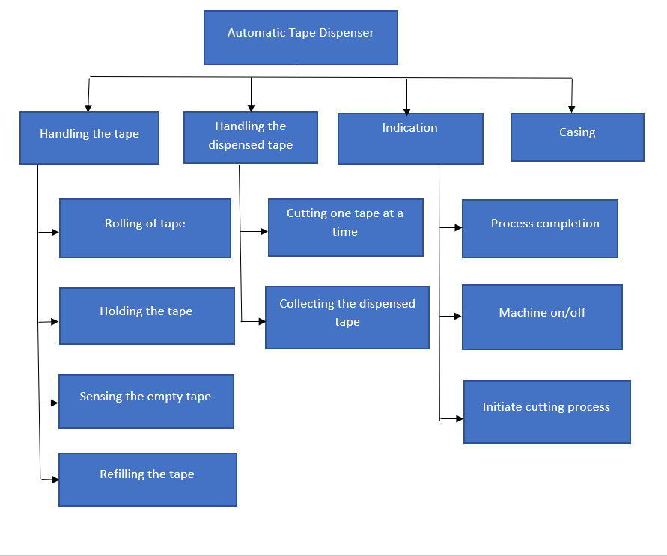
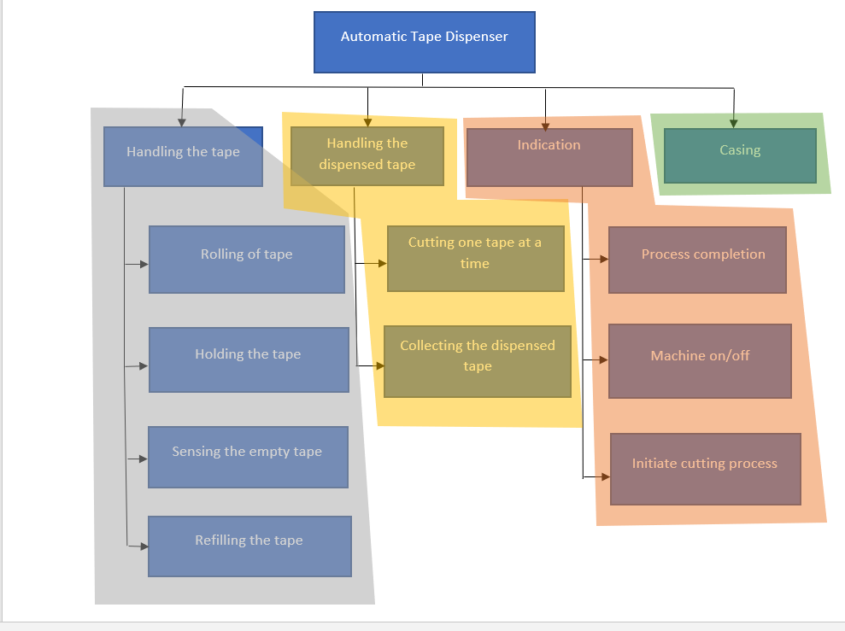
Function Tree and Functional clustering
Functional Tree
Functional Clustering

Slide 4
Sub Systems Identified
The identified subsystems are:
Tape handling unit.
Indication unit.
Dispensing and cutting unit.
Casing.

Slide 5
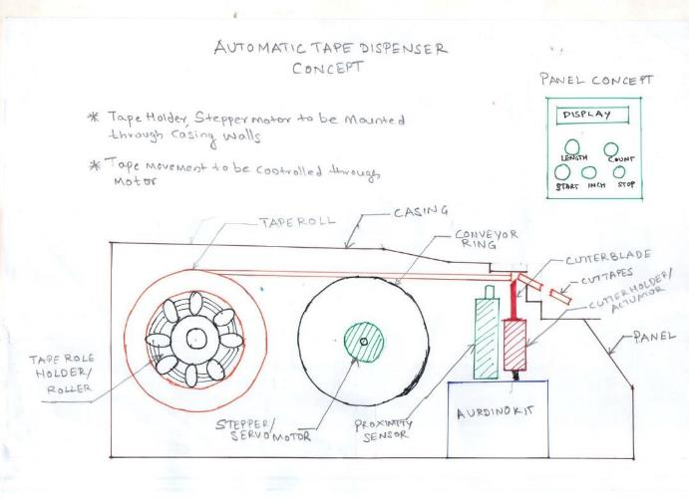
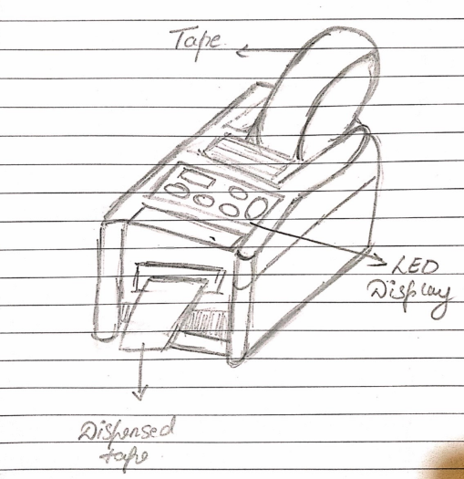
Generated Concepts
Concept 1
Concept 2

Slide 6
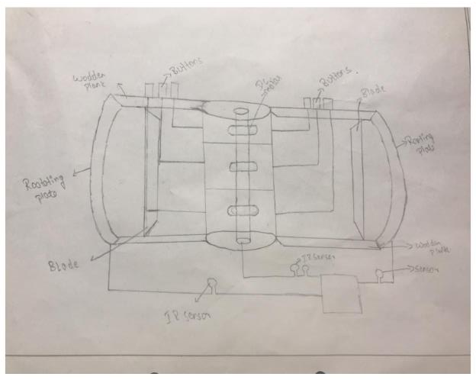
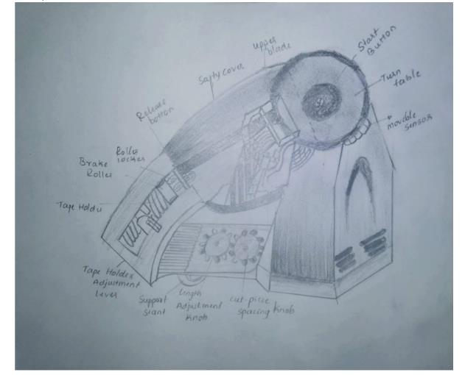
Generated Concepts
Concept 3
Concept 4

Slide 7
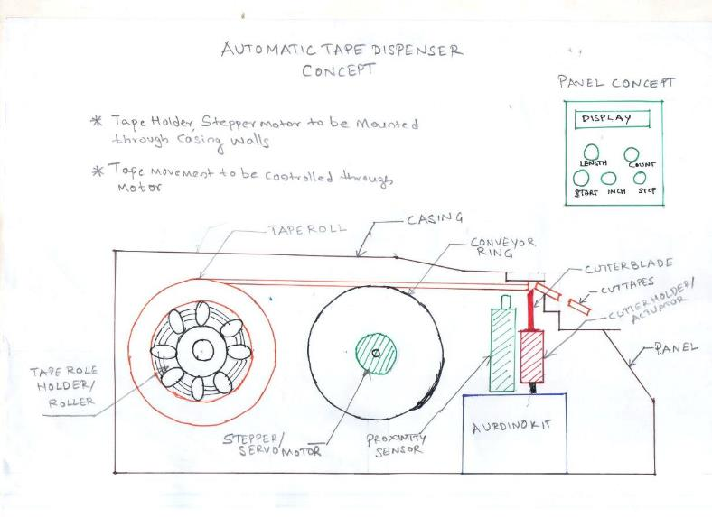
Selected Concept

Slide 8
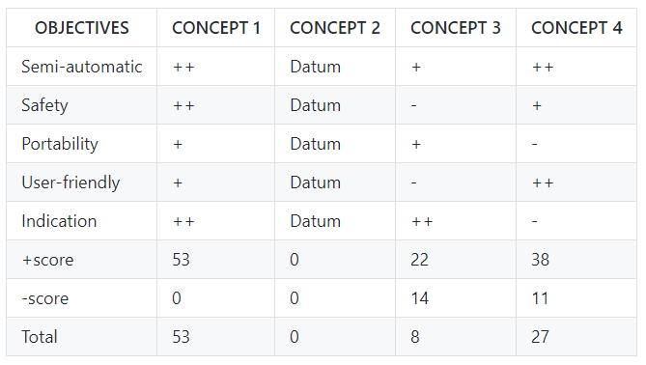
Pugh Chart

Slide 9
Virtual Implementation

Slide 10
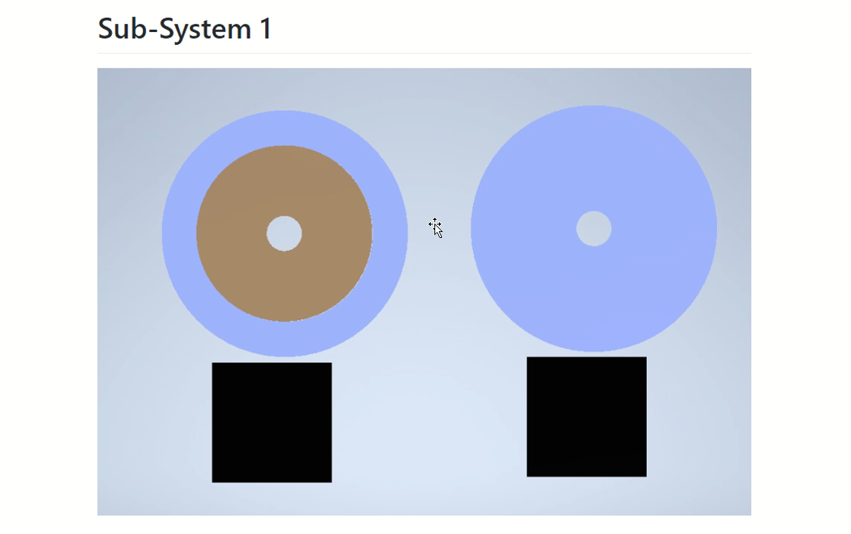
3D model of the entire system

Slide 11
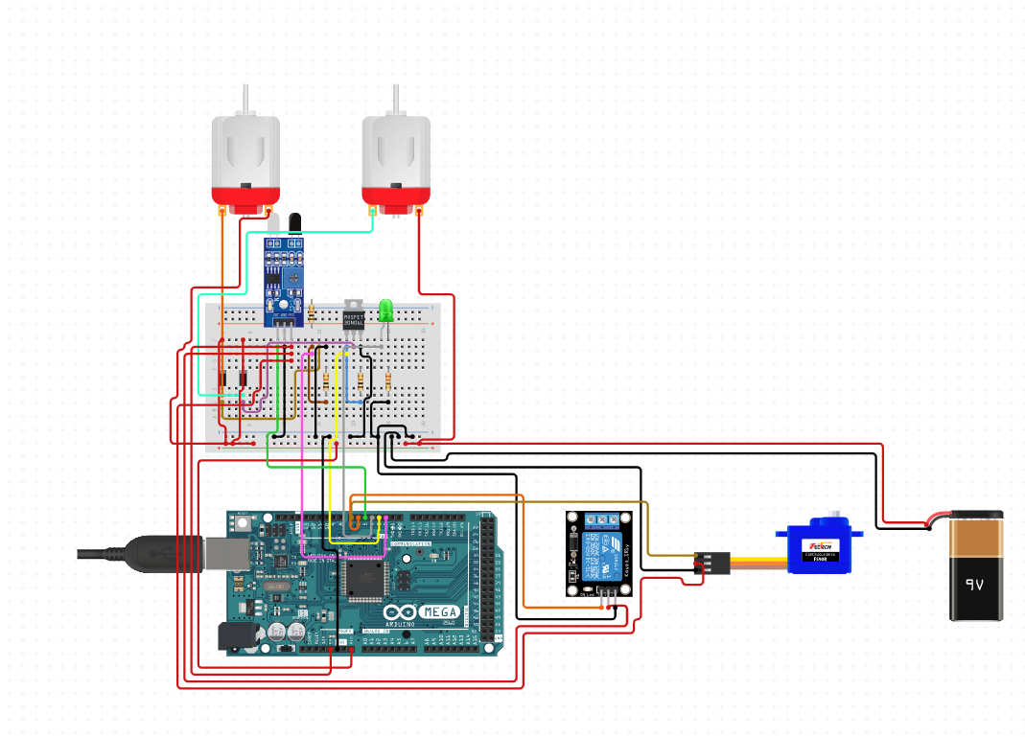
Circuit diagram of the entire system

Slide 12
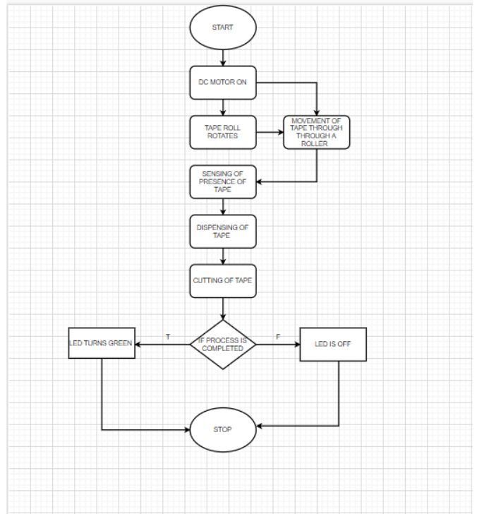
Flow chart / Simulink model of the entire system

Slide 13
Bill of materials required for the entire system
Sr.no | Part name | Material | Specification | Quantity | Function
1 | Tape holder | Acrylic sheet, plastic | Diameter-25mm Thikness-10mm | 1 | To rotate the tape roll
2 | DC motor/stepper motor |  | 12V, 10rpm | 2
3 | Roller | Acrylic sheet, plastic | Diameter-35mm Thikness-10mm | 1 | To rotate the tape
4 | Base | Acrylic sheet, plastic |  | 2/3 | To hold the motor and at as a base.
5 | IR sensor |  | Appropriate in sensing obstacles | 1 | To sense the presence of tape
6 | Housing of controller | Acrylic sheets |  | 4
7 | Blade and a rod | Metal and plastic respectively |  | 1 | cutting
8 | Device controller | Arduino | Arduino mega 2560 | 1 | Controlling the hole process
9 | Servo motor |  |  | 1 | Rotation of tape
10 | Housing parts | Acrylic sheets | 130mmx50mm | 6 | Housing of the device
11 | Led bulbs |  | Red and green color | 1 | Indicating whether the process is completed or not
12 | 12/9v battery |  | Power generation | 2 | For power generation
13 | Servo motor |  |  | 1 | Cutting of tape through blade

Slide 14
Motor Sizing and Battery Sizing of the entire system
MOTOR SIZING
DC motor required =1/2
Servo motor required=1
For tape roller
Passing of tape
Cutting of tape
FOS=1.5
1.For tape rolling and Passing of tape
Total mass acting=500gm=0.5kg
Radius=2cm
Torque=m*r=0.5*2*1.5=1.5kg-cm
rpm of motor required=60 rpm
3.Cutting of tape
We will be using servo motor for movement of blade in angels for cutting of tape.
BATTERY SIZING
No. of Motors=2
Assuming current supply=0.3A
Should run efficiently for 3 hours
Therefor battery sizing=no of motors*current supply*no of hours
=2*3*0.3
=1.8Ah

Slide 15
Functional specifications of the entire system
SR.NO | FUNCTIONS | SPECIFICATIONS
1 | Holding of the tape | Tape should be held or kept in this unit.
2 | Rolling of the tape | The tape should rotate with DC motor
3 | Sensing and refilling of tape | IR sensor should sense when the tape is empty so that it should be refiled.
4 | Dispense the cut tape | The tape should be dispensed out so that it can be cut and the user can take it out.
5 | Cutting of tape | When the tape is dispensed it should cut the tape one by one of the specified length.
6 | Process indication | Should indicate through led bulb when the process is complete.

Slide 16
Modeling and Simulation

Slide 17
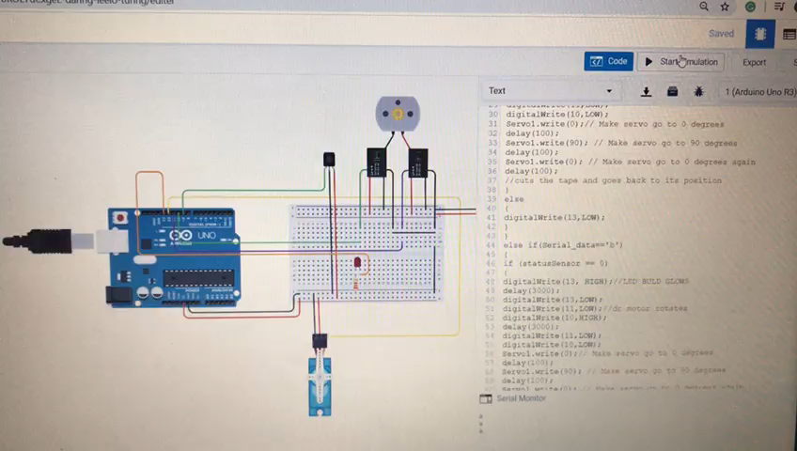
Model Simulation

Slide 18
Software and Applications Used
The software used are-
Git Hub – For documentation
Autodesk Inventor – For 3D Modeling
Thinkercad – For Modeling and Simulation
Clideo app – For video documentation

Slide 19
Acknowledgement
We would like to thank,
Dr. Gopalkrishna H Joshi, Head, Centre for Engineering Education,
Prof. Sharanappa A, Our Guide,
Prof. Ashwin K, Division Faculty,
Other faculty and supporting staff, CEER department,
Dr. Ashok Shettar, Vice Chancellor, KLE Technological University,
Registrar, Dean Academics, KLE Technological University,
Who provided all the guidance and support in completing this course project.

Slide 20
Thank You
Presented By-
Anirudh Kulkarni
Akashini Koppad

